Slide 1
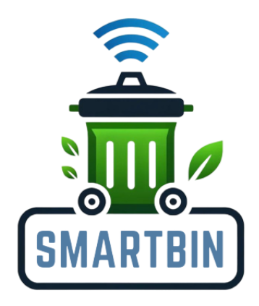
Project Smart Bin

Slide 2
Overview
Project Name | Smart Bin
Team Name | Team Odyssey
Contacts | zhang.yangda16@gmail.com
Technical Field | Environmental Technology, Smart Systems
Technologies | IoT (Internet of Things), Camera Recognition, QR Code Scanning, Mobile Application Development, Data Analytics, Machine Learning
Keywords | Waste Management, Smart Bin, Recycling
Applicable Fields | Waste management, Urban Planning, Environmental Conservation, Smart Cities
Description (in 500 words) | For a comprehensive description of the usage scenarios, pain points solved, and innovations of the Smart Bin project, please refer to Annex 1.

Slide 3
Team Introduction
Zhang Yangda
Ahmed Shaiyan Alam
Palinya Sengdalavong
Dhiraputta Pathama Tengara
Role:
Frontend Developer
Education:
Y3 NUS Computer Engineering
Experience:
Entry-Level Software Engineer
Role:
Frontend Developer
Education:
Y3 NUS Computer Engineering
Experience:
Entry-Level Software Engineer
Role:
Graphic designer
Education:
Y3 SUTD Computer Science
Experience:
Entry-Level Graphic Designer
Role:
AI Engineer & Backend Developer
Education:
Y3 NUS Computer Science
Experience:
Entry-Level AI Developer

Slide 4
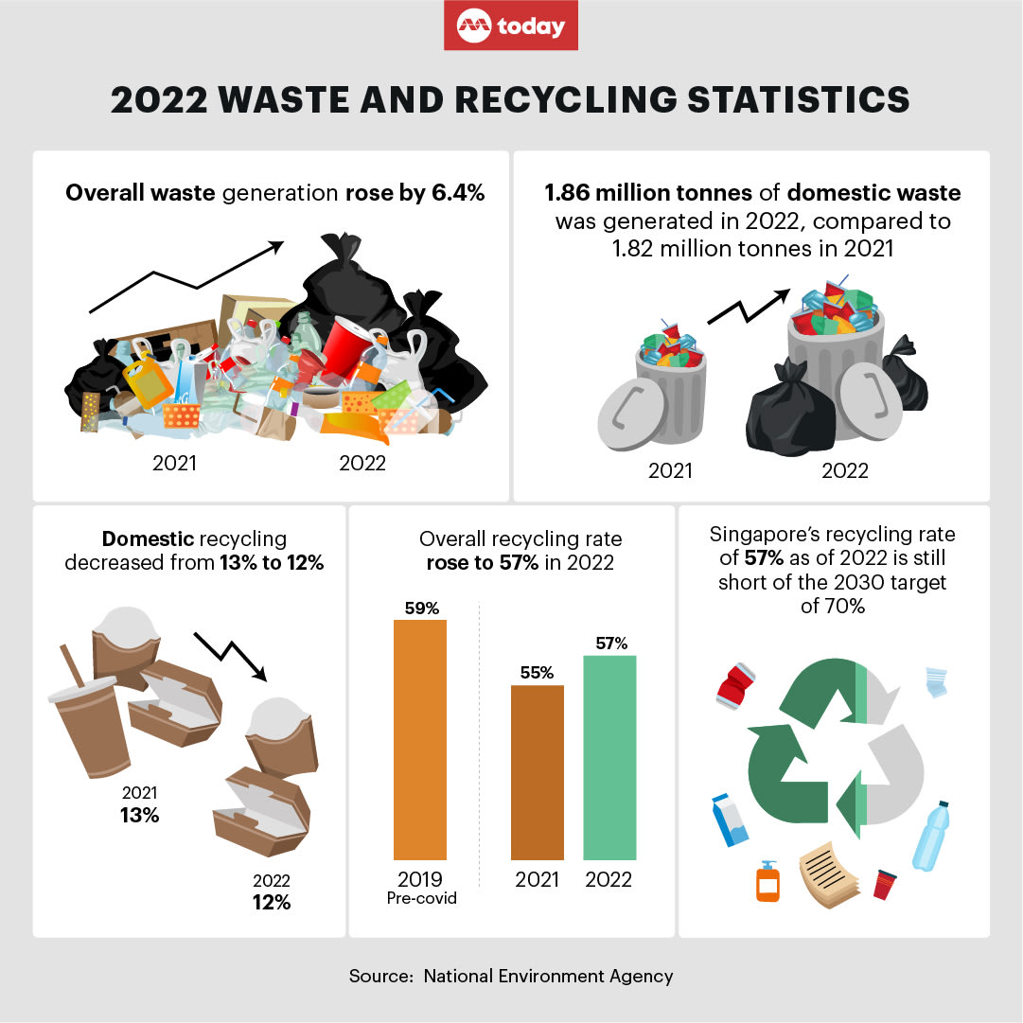
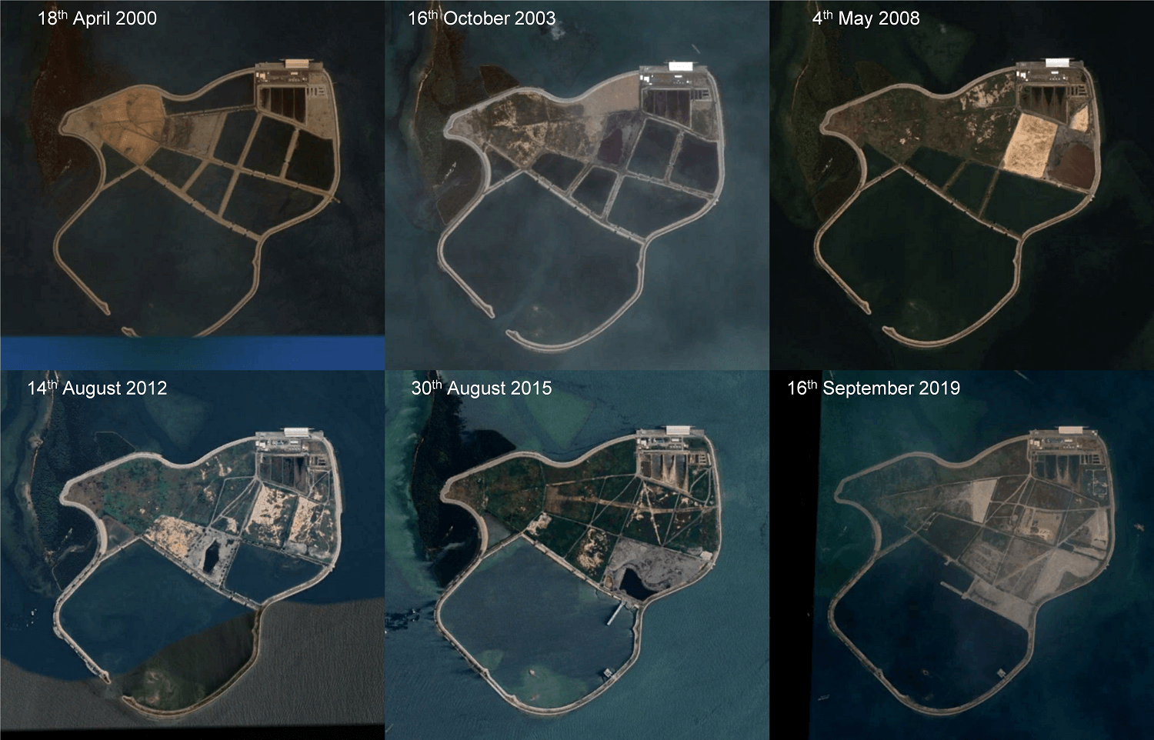
Problem: With limited land area, Singapore’s one and only landfill is running out at a rapid rate and the current recycling rate is still lower than the target.
https://www.reddit.com/r/singapore/comments/10j8zjy/end_of_life_for_pulau_semakau_landfill_by_2035/?rdt=34106
Notes:
Singapore's recycling rate of 57 per cent as of last year is still short of the 2030 target of 70 per cent.
Singapore generated more domestic waste last year than in 2021, and its domestic rate of recycling fell slightly to the lowest level in over a decade as higher freight costs meant less waste than usual was exported for recycling.
In 2022, as economic activity picked up, 1.86 million tonnes of domestic waste was generated, compared to 1.82 million tonnes the year before, the National Environment Agency (NEA) said on Wednesday (May 3).
The fall in the domestic recycling rate from 13 per cent to 12 per cent was largely due to a drop in paper, cardboard, textile and leather waste recycled, it reported in its 2022 Waste and Recycling Statistics.

Slide 5
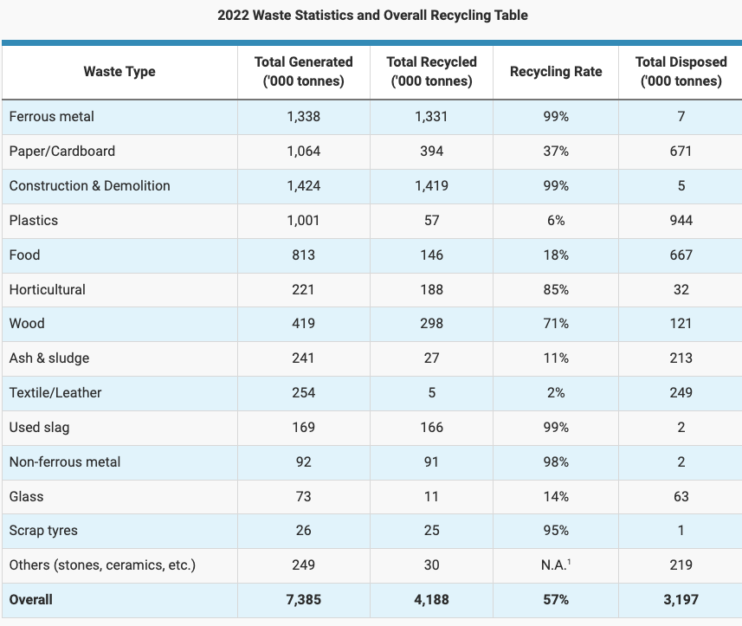
Types of waste produced in Singapore
We observe that most recyclable waste originates from non-domestic sources. However, only a significantly small percentage of domestic waste, including paper, plastics, textiles, and glass, is recycled.
The total volume of domestic waste (plastics, food, textile/leather, glass, and paper/cardboard) is substantial, contributing significantly to the overall waste generated. For example, plastics alone account for over 1 million tonnes of waste. Increasing the recycling rates for these materials can drastically reduce the amount of waste sent to landfills.
Increasing the recycling rates for domestic waste aligns with Singapore’s sustainability targets and national agendas, such as the Sustainable Singapore Blueprint and the Zero Waste Masterplan. Achieving higher recycling rates is essential for meeting these national objectives and promoting a sustainable future.
Source: National Environmental Agency (NEA)
https://www.mse.gov.sg/resources/zero-waste-masterplan.pdf

Slide 6
Project Introduction
The "Smart Bin" project addresses the critical issue of low recycling rates in Singapore by making recycling more accessible, engaging, and educational. This innovative solution features AI-powered sorting, smart cameras, and mobile app integration to transform waste management practices. In public spaces like shopping malls, parks, and transport stations, Smart Bins handle large volumes of waste, ensuring proper segregation and recycling. Residential areas benefit from the convenience and educational features, encouraging households to participate in recycling programs. Corporate offices can use Smart Bins to promote corporate social responsibility and reduce their environmental footprint. Schools and universities can integrate these bins into their sustainability initiatives, teaching students about recycling and environmental stewardship. The Smart Bin solves the complexity of recycling by automatically sorting waste using AI algorithms and smart cameras, reducing user burden and increasing accuracy. It addresses the lack of information by providing educational resources through a mobile app, which also helps users locate nearby Smart Bins.

Slide 7
To tackle engagement and motivation issues, the Smart Bin makes recycling fun and informative, incorporating gamification elements like rewards for frequent recyclers. Traditional waste management inefficiencies are mitigated by the Smart Bin's ability to improve waste collection and sorting efficiency, ensuring more materials are recycled and less waste ends up in landfills. The key innovations include AI-powered sorting, enhancing waste segregation accuracy and reducing contamination; smart cameras that guide users on proper waste disposal; and a mobile app that offers educational resources, tracks recycling habits, and provides rewards for consistent participation. Gamification elements create a sense of accomplishment and encourage ongoing participation, making recycling more appealing. By addressing these pain points and introducing innovative features, the Smart Bin project has the potential to significantly increase recycling rates and promote environmental sustainability in Singapore and beyond.

Slide 8
Feasibility
Supportive Government
Public Awareness
Singapore has a strong commitment to environmental sustainability, with government policies and initiatives aimed at promoting recycling and reducing wastes.
There is a growing awareness and concern about environmental issues among Singapore’s population, and the concept of sustainability is deeply embedded in Singapore’s education system.
Corporate and Institutional Buy-In
Technological Infrastructure
Singapore’s businesses and institutions are increasingly embracing sustainability practices. The Smart Bin project can find ready adopters in corporate offices, schools, universities, and public spaces, ensuring widespread implementation and impact.
The country’s strong ICT infrastructure ensures reliable connectivity and data management for the smart features of the bins.

Slide 9
Sustainability of Smart Bin
Waste Reduction: By sorting and recycling waste efficiently, the Smart Bin reduces the volume of waste sent to landfills, conserving land and reducing pollution.
Resource Conservation: Recycling materials like paper, plastics, and textiles conserves natural resources and reduces the need for raw material extraction, preserving ecosystems and reducing environmental degradation.
Carbon Footprint Reduction: Improved recycling practices decrease the energy consumption associated with producing new materials, thereby lowering greenhouse gas emissions and contributing to climate change mitigation.
Environmental
Cost Savings: Efficient waste sorting and recycling can reduce the costs associated with waste disposal and landfill management. It also opens up opportunities for the sale of recycled materials, providing economic benefits.
Job Creation: The recycling industry can create jobs in waste collection, sorting, processing, and recycling, contributing to economic growth and sustainability.
Educational
Economic
Awareness and Behaviour Change: The Smart Bin project includes educational components that inform and engage the public, particularly teenagers and youths, fostering a culture of environmental responsibility. By making recycling fun and rewarding, it encourages long-term behavioural change towards sustainable practices.

Slide 10
Business Value
Revenue Streams
Cost Savings
The primary source of revenue can come from selling or leasing Smart Bins to municipalities, businesses, educational institutions, and residential communities.
Offering a subscription-based model for the mobile app that provides premium features, such as detailed analytics on recycling habits, personalized tips, and advanced waste management insights
The mobile app and Smart Bins can serve as platforms for targeted advertisements from eco-friendly brands and local businesses
Charge platform fee on the eco-friendly stores that post their products on the mobile app.
Government Funding
Some of the Smart Bins that are placed outdoor can be powered by built-in solar panels to reduce operational cost.
The AI-powered sorting mechanism and smart cameras reduce the need for manual sorting, lowering labor costs for waste management companies and municipalities.
The smart technology integrated into the bins can provide real-time monitoring and alerts for maintenance needs, reducing downtime and associated costs.

Slide 11
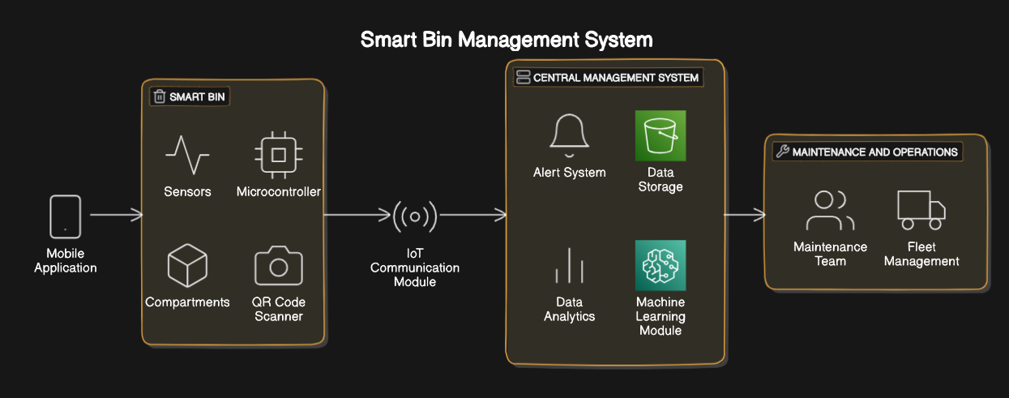
Technology implementation
Mobile Application - Smart Bin - IoT Communication Module
Central Management System - Maintenance and Operations

Slide 12
Technology implementation
IoT Integration
The Smart Bin system employs IoT technology to connect each bin to a central management system. Each bin is equipped with sensors that monitor the fill level of each compartment. This real-time data is transmitted to the central system, allowing for efficient waste collection scheduling. Maintenance teams receive alerts when bins are nearly full, optimizing collection routes and reducing operational costs. This system ensures timely emptying of bins, preventing overflow and maintaining cleanliness in urban areas.

Slide 13
Mobile Application Development
Source code: https://github.com/HuaweiSmartBin/smart-bin-app
Our mobile application is designed with a user-centric approach to facilitate efficient and convenient waste management. The app features a comprehensive home page that incorporates a map displaying the nearest recycling bins. This is achieved using the Google Maps API, which also marks the locations of all available bins in the area, ensuring users can easily find the closest bin to dispose of their waste. In addition to the home page, the app includes several other key functionalities:
Scan Function: Accessible through a dedicated tab, this feature integrates the device's camera for capturing images of waste items. The captured images are then processed through a classification function, leveraging machine learning to accurately identify the type of waste. Detailed information about this classification function is provided in the subsequent page focusing on our machine learning implementation.
Online Store: This page allows users to accumulate rewards each time they dispose of waste correctly. These rewards can be redeemed in the online store, encouraging responsible waste disposal habits.
Personal Account Page: This section of the app stores personal user information and provides options for users to update their details. It ensures a personalized experience and keeps track of individual waste disposal activities and rewards.
Overall, our mobile app not only simplifies the process of locating and using recycling bins but also incentivizes users to participate actively in waste management through rewards and personalized tracking.

Slide 14
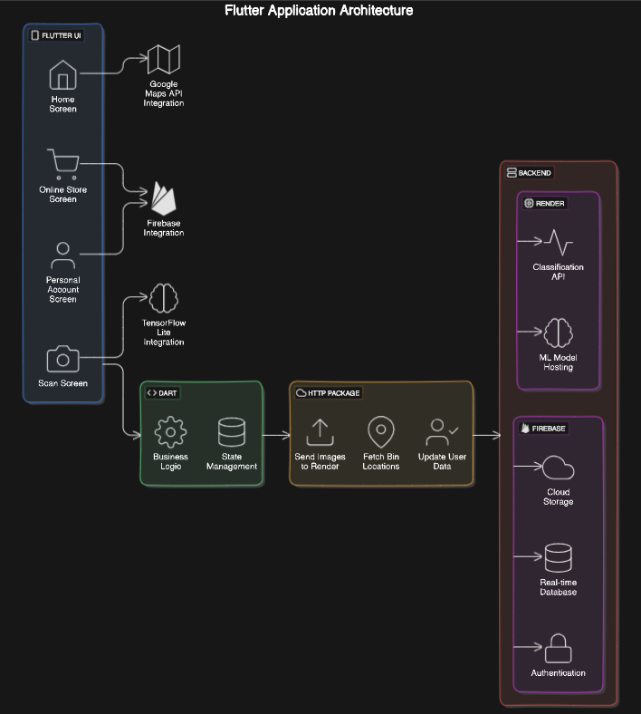
Tech Stack
Flutter
Dart
Google Maps API
TensorFlow Lite
Firebase
HTTP Package
Render
Firebase

Slide 15
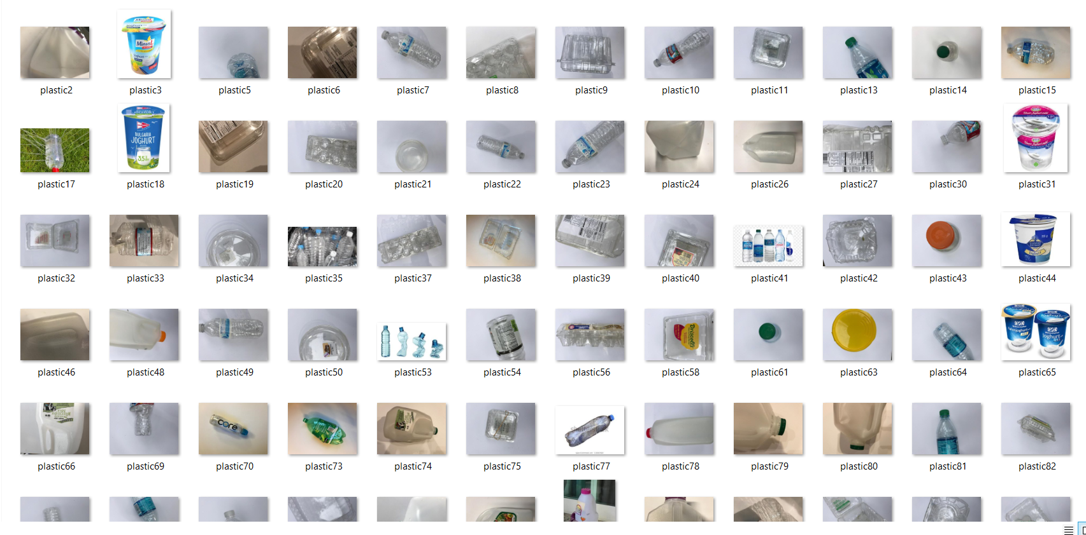
Machine Learning Model
Source code of the model: https://github.com/HuaweiSmartBin/model-api
Our machine learning model is a crucial component of our smart waste management application, designed to accurately classify different types of waste using advanced image recognition techniques. Here’s an overview of our model and its deployment:
Training the Model
Dataset: Our model is trained on a carefully curated dataset consisting of 3000 sample images of rubbish. These images cover a diverse range of waste categories to ensure the model's robustness and accuracy.
Categories: The dataset includes six different waste categories:
Paper
Plastic
Glass
Metal
E-waste
Organic

Slide 16
Model Architecture: We utilize TensorFlow, an open-source machine learning framework, to develop our image classification model. TensorFlow provides the tools and flexibility needed to create a high-performing model tailored to our specific requirements.
TensorFlow Lite Conversion
Optimization: To enable efficient inference on mobile devices, we convert our TensorFlow model to TensorFlow Lite (TFLite). TensorFlow Lite is a lightweight solution for mobile and embedded devices that allows us to run our model with low latency and minimal resource usage.
Deployment: The converted TensorFlow Lite model is then deployed on Render, a cloud platform that provides scalable and reliable hosting solutions. This setup allows our mobile application to send captured images to the server, where the model processes them and returns the classification results.
Classification Process
Image Capture: Users capture images of waste items using the camera feature integrated into our mobile application.
Image Processing: The captured image is sent to our server where the TensorFlow Lite model is hosted. The model processes the image and classifies it into one of the six predefined categories: paper, plastic, glass, metal, e-waste, or organic.
Confidence Level: The model outputs the highest confidence level category for the given image. If the confidence level exceeds a threshold of 0.85, the classification result is considered valid and displayed to the user.
Retake Request: If the confidence level is below 0.85, the application prompts the user to retake the photo to ensure better accuracy. This threshold ensures that only high-confidence classifications are accepted, minimizing errors and improving the overall reliability of the system.

Slide 17
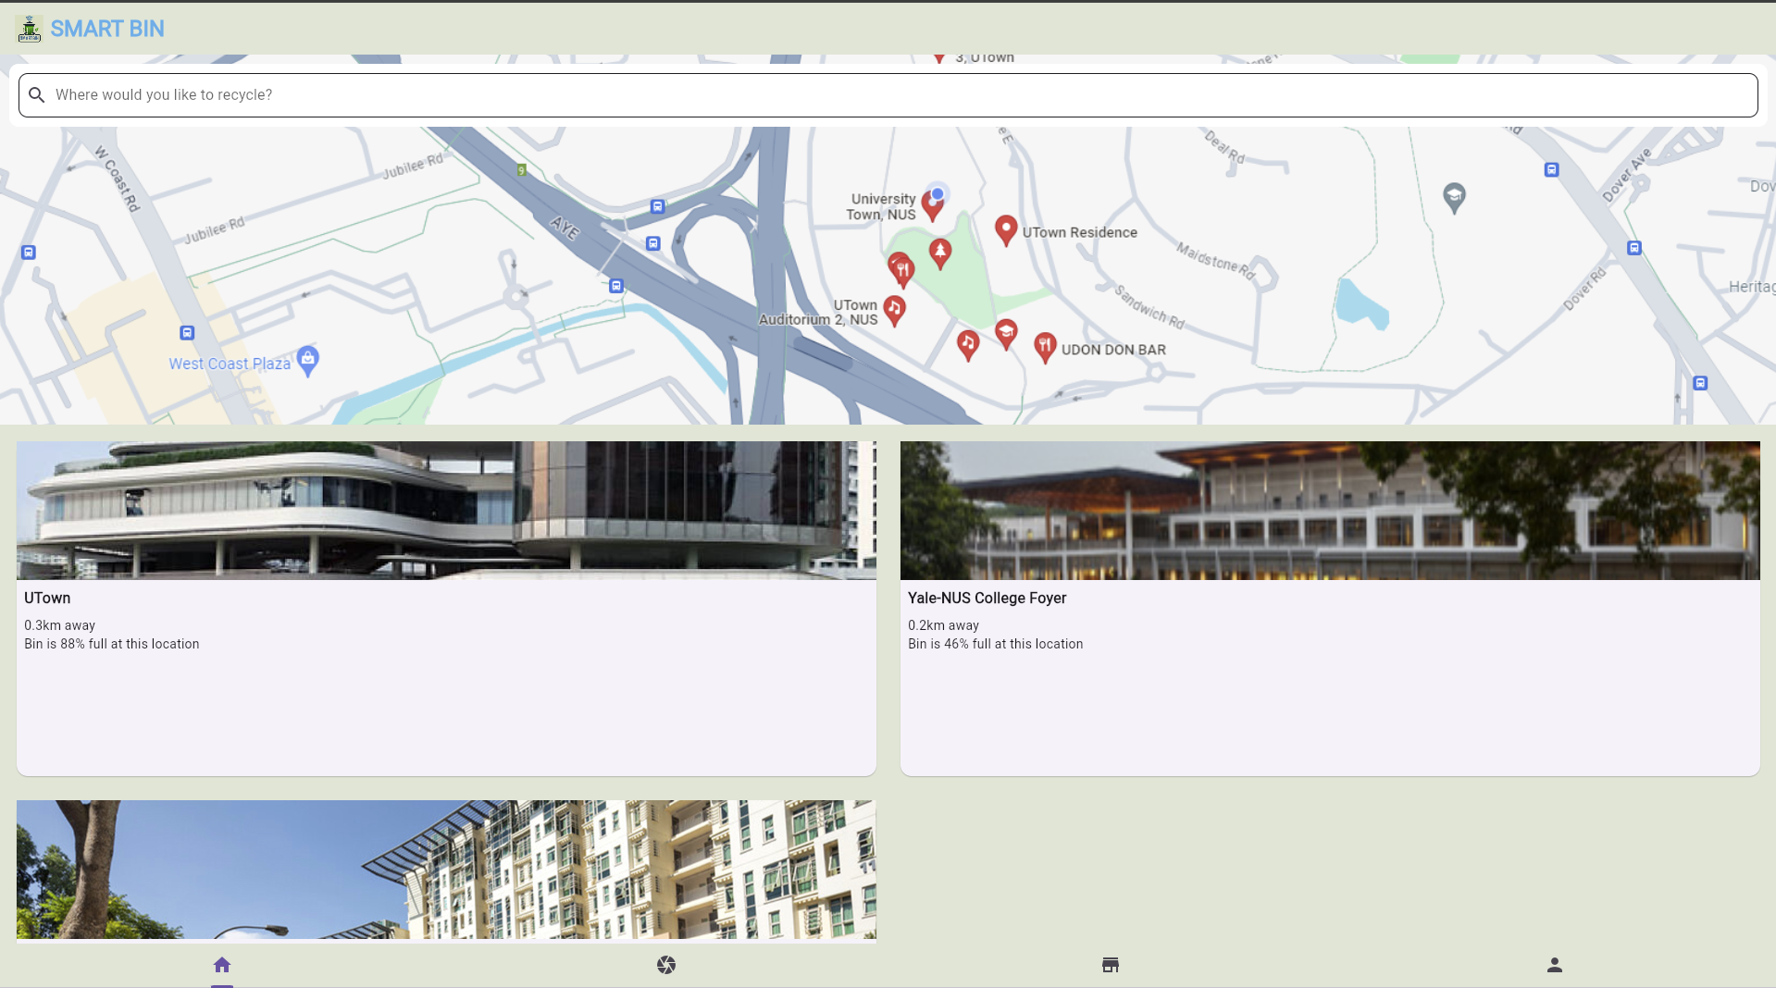
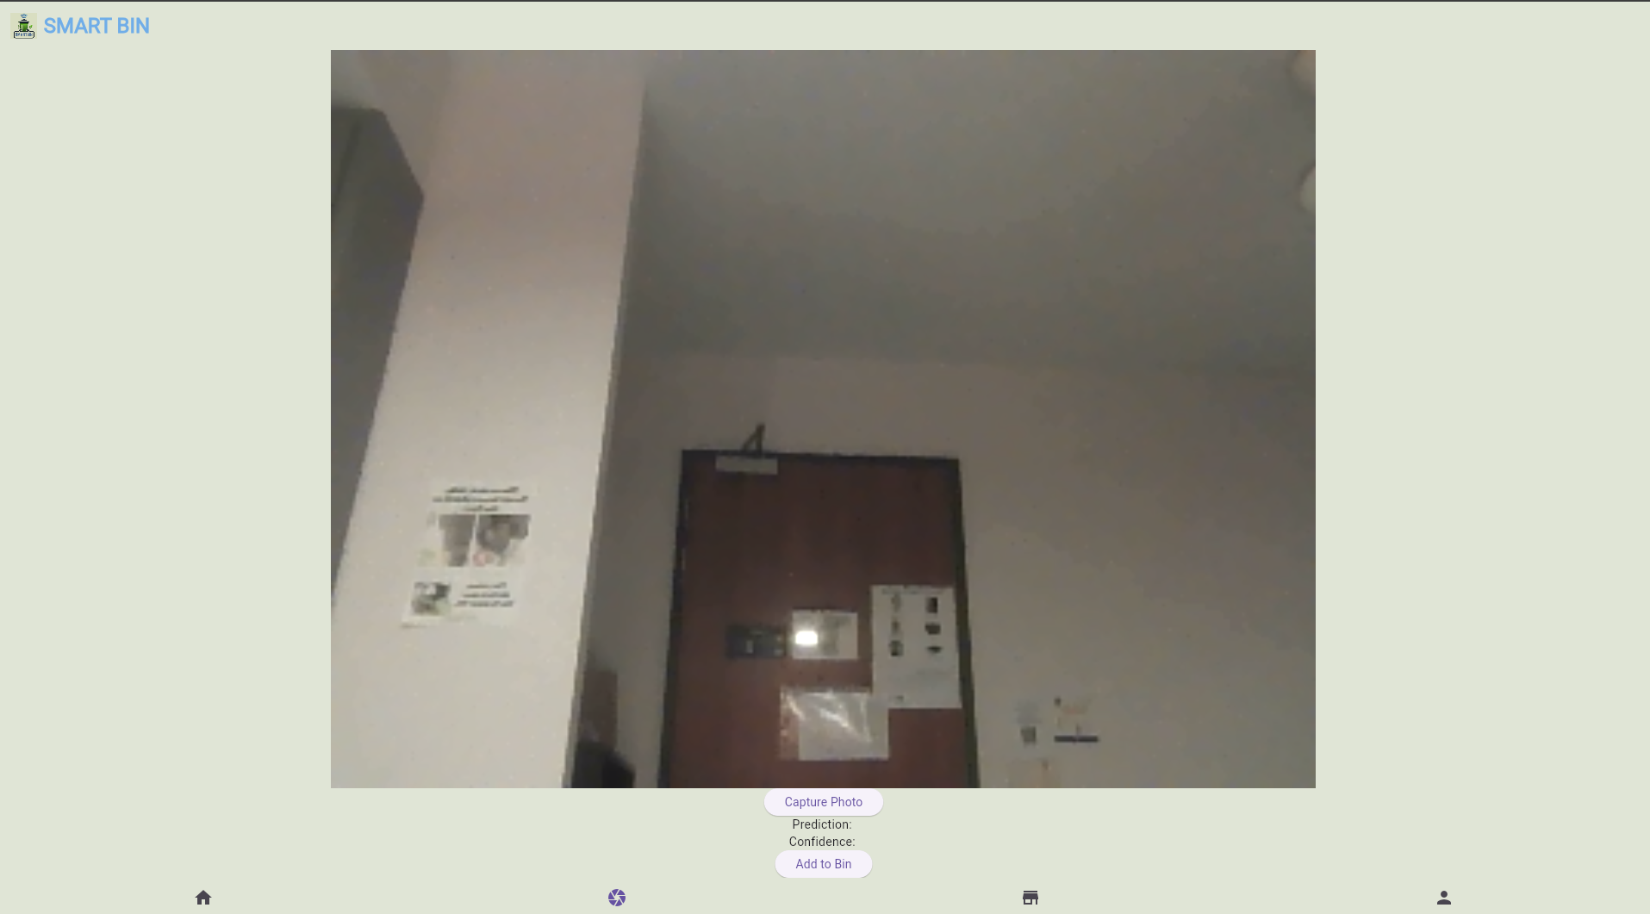
User Interface
Home Screen
This page features a Google Maps widget that helps users
locate the nearest smart bin. Additionally, it includes widgets
that display the distance to each smart, as well as their current
capacity
Camera Page
The Camera page utilizes a machine learning model to identify objects that users intend to dispose of in the smart bin. Users are prompted to take a picture of the object. Once the identification is complete, they can use the 'Add to Bin' button to register the object.

Slide 18
Social Value
By making recycling easy, fun, and informative, it encourages individuals to adopt more sustainable waste management practices.
Educational components, such as the mobile app, inform users about proper recycling practices, thereby increasing public knowledge about waste segregation and environmental conservation.
Incorporating gamification elements, such as rewards for consistent recycling, this will attract people especially younger generation to recycle more often.
By reducing the strain on Singapore's only landfill and mitigating the need for additional waste disposal sites, the project supports the long-term health and well-being of the population.

